Slide 1

Jetty and Tomcat
WAR Files
Tomcat
Apache Jetty
HelloWorld Servlet

Slide 2
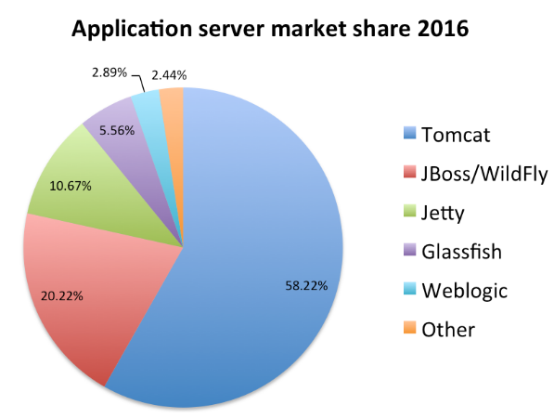
See Also
https://www.youtube.com/watch?v=MIvlWrhY50o
https://tomcat.apache.org/
http://www.eclipse.org/jetty/
https://dzone.com/articles/most-popular-java-ee-servers-2016-edition
Notes:
Some additional information on concurrency

Slide 3
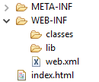
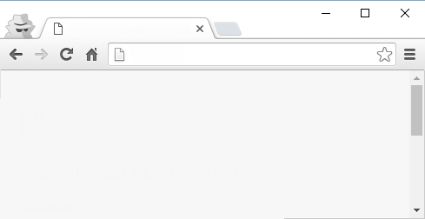

Web Archives (WAR not JAR)
Standard JAR stuff
Java code (servlets)
Other libraries you need
Configuration Information
Static resources (subdirectories)
uah/pets/owners
WebGrades.war
uah/grades/history
Pets.war
uah/bookit/pubs
Apache Tomcat
GlassFish
Jetty
Books.war
Streams of bytes … two ways (into your program and out of your program)
Disks, consoles, sockets, keyboards, printers
Know how to talk streams and you can talk to anything
Initialization (constructor) is different. Use is the same.

Slide 4
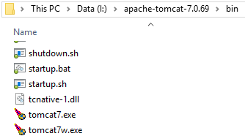
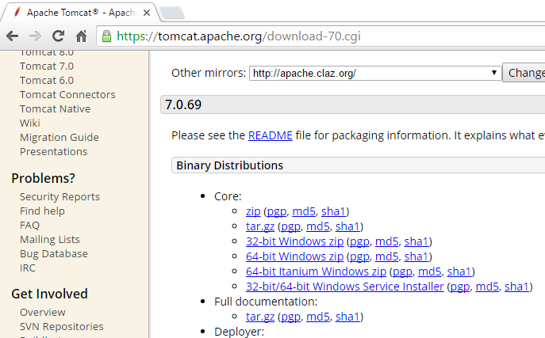
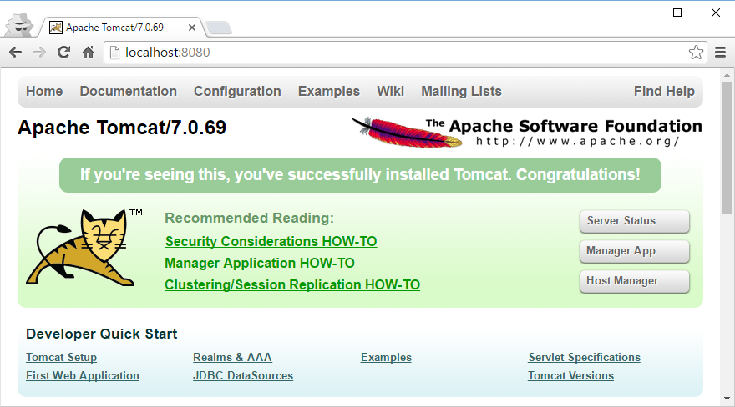
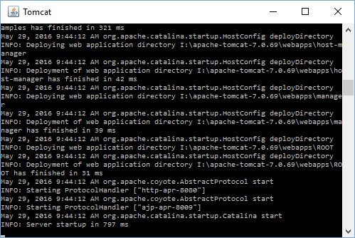
Installing Tomcat
Download the ZIP file
UNZIP it (like in the root of the C drive)
Run the “startup.bat”
You can also make Tomcat a service
Connect with your browser
Streams of bytes … two ways (into your program and out of your program)
Disks, consoles, sockets, keyboards, printers
Know how to talk streams and you can talk to anything
Initialization (constructor) is different. Use is the same.

Slide 5
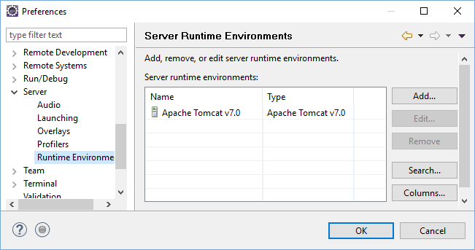
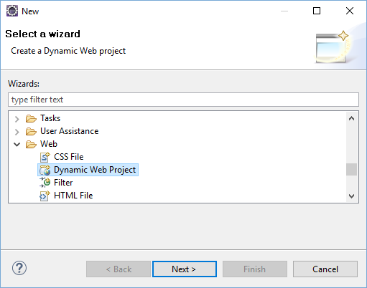
Telling Eclipse About Tomcat
Streams of bytes … two ways (into your program and out of your program)
Disks, consoles, sockets, keyboards, printers
Know how to talk streams and you can talk to anything
Initialization (constructor) is different. Use is the same.

Slide 6
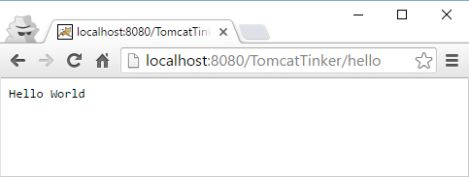
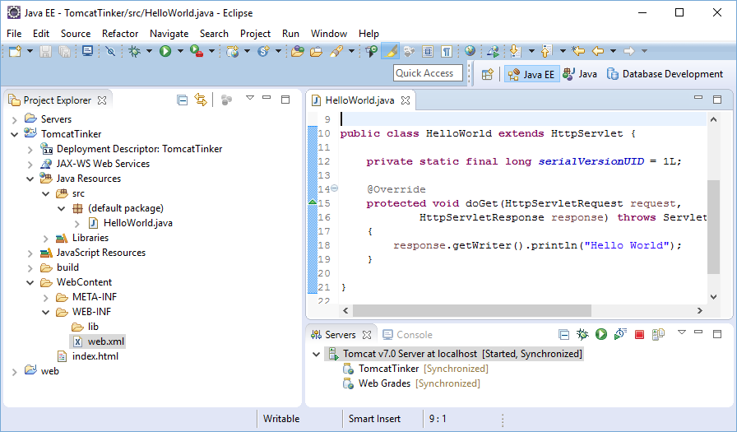
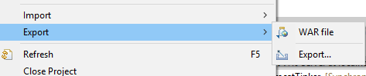
Running Tomcat in Eclipse
Streams of bytes … two ways (into your program and out of your program)
Disks, consoles, sockets, keyboards, printers
Know how to talk streams and you can talk to anything
Initialization (constructor) is different. Use is the same.

Slide 7
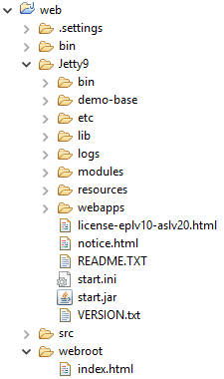
Apache Jetty
Web server and servlet container written in Java
Open source maintained by the Eclipse Foundation
Embed the web server in your code (like we did with the Derby DB)
Create a regular Java project
Download the ZIP and expand it into your project like a “lib” directory
Configure Eclipse to reference all the jars
Make a root directory for your web content
Streams of bytes … two ways (into your program and out of your program)
Disks, consoles, sockets, keyboards, printers
Know how to talk streams and you can talk to anything
Initialization (constructor) is different. Use is the same.

Slide 8
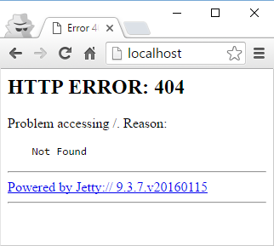
Simple Server
import org.eclipse.jetty.server.Server;
public class GradeServer {
public static void main(String[] args) throws Exception {
Server server = new Server(80);
server.start();
}
}
Streams of bytes … two ways (into your program and out of your program)
Disks, consoles, sockets, keyboards, printers
Know how to talk streams and you can talk to anything
Initialization (constructor) is different. Use is the same.

Slide 9
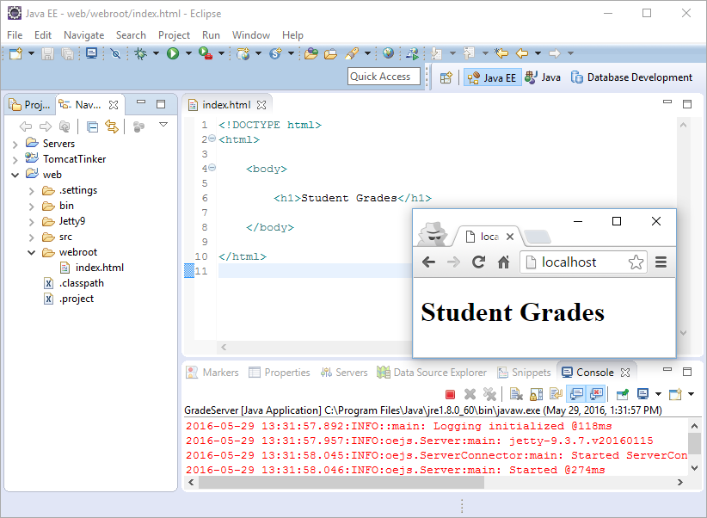
Handlers
// For static files
ResourceHandler staticFilesHandler = new ResourceHandler();
String [] welcomeFiles = {"index.html"};
staticFilesHandler.setWelcomeFiles(welcomeFiles);
staticFilesHandler.setResourceBase("webroot");
// Container of handlers
HandlerList handlers = new HandlerList();
handlers.addHandler(staticFilesHandler);
Server server = new Server(80);
server.setHandler(handlers);
server.start();
Streams of bytes … two ways (into your program and out of your program)
Disks, consoles, sockets, keyboards, printers
Know how to talk streams and you can talk to anything
Initialization (constructor) is different. Use is the same.

Slide 10

Hello World Servlet
public class HelloServlet extends HttpServlet {
private static final long serialVersionUID = 1L;
@Override
protected void doGet(HttpServletRequest request,
HttpServletResponse response) throws ServletException, IOException
{
response.setContentType("text/html");
response.setStatus(200); //HttpServletResponse.SC_OK
PrintWriter pw = response.getWriter();
pw.println("<h1>Hello World</h1>");
}
}
Servlet
Streams of bytes … two ways (into your program and out of your program)
Disks, consoles, sockets, keyboards, printers
Know how to talk streams and you can talk to anything
Initialization (constructor) is different. Use is the same.

Slide 11
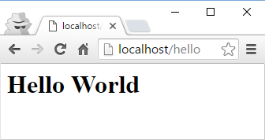
Servlet Container
// For static files
ResourceHandler staticFilesHandler = new ResourceHandler();
String [] welcomeFiles = {"index.html"};
staticFilesHandler.setWelcomeFiles(welcomeFiles);
staticFilesHandler.setResourceBase("webroot");
// HelloServlet
ServletHandler servletHandler = new ServletHandler();
servletHandler.addServletWithMapping(HelloServlet.class,"/hello");
// Container of handlers
HandlerList handlers = new HandlerList();
handlers.addHandler(servletHandler);
handlers.addHandler(staticFilesHandler);
Server server = new Server(80);
server.setHandler(handlers);
server.start();
Streams of bytes … two ways (into your program and out of your program)
Disks, consoles, sockets, keyboards, printers
Know how to talk streams and you can talk to anything
Initialization (constructor) is different. Use is the same.

Slide 12
Live Example
AJAX “getNumber” example from before
Static content from before
Start to finish
Streams of bytes … two ways (into your program and out of your program)
Disks, consoles, sockets, keyboards, printers
Know how to talk streams and you can talk to anything
Initialization (constructor) is different. Use is the same.

Slide 13

Tinkering
Try the Jetty servlet example for yourself.
Make a RandomNumber servlet that creates an HTML page with a random number.
Create a static page with a link to the RandomNumber servlet.

